Slide 1
OSHA Update
ASSP Pensacola
Pensacola, Florida, 8/17/23
Francisco J. Garcia
Compliance Assistance Specialist
Occupational Safety and Health Administration
Notes:
Note to presenters: This presentation was last updated in January 2023 but is continuously being updated as time permits. Please review content before use!

Slide 2
Disclaimer
This information has been developed by an OSHA Compliance Assistance Specialist and is intended to assist employers, workers, and others improve workplace health and safety. While we attempt to thoroughly address specific topics [or hazards], it is not possible to include discussion of everything necessary to ensure a healthy and safe working environment in this presentation. This information is a tool for addressing workplace hazards, and is not an exhaustive statement of an employer’s legal obligations, which are defined by statute, regulations, and standards. This document does not have the force and effect of law and is not meant to bind the public in any way. This document is intended only to provide clarity to the public regarding existing requirements under the law or agency policies. It does not create (or diminish) legal obligations under the Occupational Safety and Health Act. Finally, OSHA may modify rules and related interpretations in light of new technology, information, or circumstances; to keep apprised of such developments, or to review information on a wide range of occupational safety and health topics, you can visit OSHA’s website at www.osha.gov.

Slide 3
OSHA’s Continuing Mission
OSHA and its state partners, coupled with efforts of employers, safety & health professionals, unions and advocates, have helped dramatically reduce workplace injuries and illnesses.
Worker fatalities in America are down—
on average, from 38 workers a day in 1970
to 13 a day in 2020.
Worker injuries and illnesses are down—
from 10.9 incidents per 100 workers in 1972
to 2.9 per 100 in 2020.
Notes:
OSHA’S CONTINUING MISSION
Over the past several decades, OSHA and its partners have worked to dramatically reduce the number of workplace injuries and illnesses.
The number of worker fatalities have dropped from an average of 38 workers a day in 1970, to 13 a day in 2020.
Worker injuries have also declined significantly, from 10.9 incidents per 100 workers in 1972 to 2.9 per 100 in 2020.
These numbers show that we have made great progress, but we still have work to do to reach the ultimate goal of zero worker fatalities, injuries, or illnesses.

Slide 4
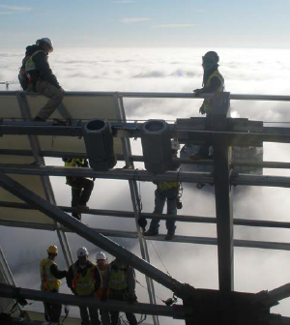
OSHA’s Balanced Approach
Enforcement
Outreach
Compliance Assistance
Notes:
OSHA’s mission has always been focused on worker safety and health. Our common goal is that every worker goes home safe and healthy at the end of each day.
The agency is committed to maintaining a balanced approach to reaching this goal – through compliance assistance and enforcement.
The vast majority of employers strive to keep their workplaces safe, and comply with applicable laws. OSHA is working to provide compliance assistance, to give employers and employees the knowledge and tools they need to comply with their obligations and stay safe. Compliance with the law is mandatory. Employers that do not comply with the law will continue to see full enforcement.

Slide 5
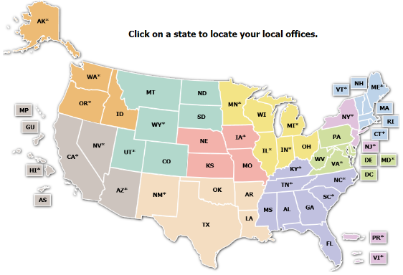
How OSHA is Organized
■ Region 1: Boston
■ Region 2: New York
■ Region 3: Philadelphia
■ Region 4: Atlanta
■ Region 5: Chicago
■ Region 6: Dallas
■ Region 7: Kansas City
■ Region 8: Denver
■ Region 9: San Francisco
■ Region 10: Seattle
Notes:
HOW OSHA IS ORGANIZED
OSHA is part of the Department of Labor.
The Agency has a central National Office, located in Washington, D.C.
OSHA also has 10 Regional Offices, which are located throughout the United States.
Each of these 10 regional geographic regions, which cover several states and contain multiple area offices.
Test Question:
22. OSHA must issue a citation within ___ of the occurrence of the violation: (TLO 5)
Three months
Six months
Twelve months
Five years
23. Citations are signed by the OSHA Area Director but they are not effective until they become a final order of: (TLO 5)
The Assistant Secretary for OSHA
The Occupational Safety and Health Review Commission
The Solicitor of Labor
The Secretary of Labor

Slide 6
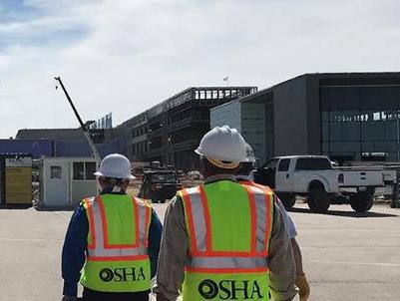
Regional and Area Office Functions
Inspections
Compliance Assistance
Outreach
Training
Penalty Collection
Abatement Assurance
Notes:
REGIONAL AND AREA OFFICE FUNCTIONS
Regional Offices include numerous Area Offices located within the Region, as well as specific programs (whistleblower protections, enforcement, cooperative and state programs, and administrative programs).
Regional and Area Office staff conduct a variety of activities. Their functions include:
investigating safety and health complaints,
performing inspections of worksites,
and conducting other activities, such as compliance assistance and training.
Test Question:
22. OSHA must issue a citation within ___ of the occurrence of the violation: (TLO 5)
Three months
Six months
Twelve months
Five years
23. Citations are signed by the OSHA Area Director but they are not effective until they become a final order of: (TLO 5)
The Assistant Secretary for OSHA
The Occupational Safety and Health Review Commission
The Solicitor of Labor
The Secretary of Labor

Slide 7
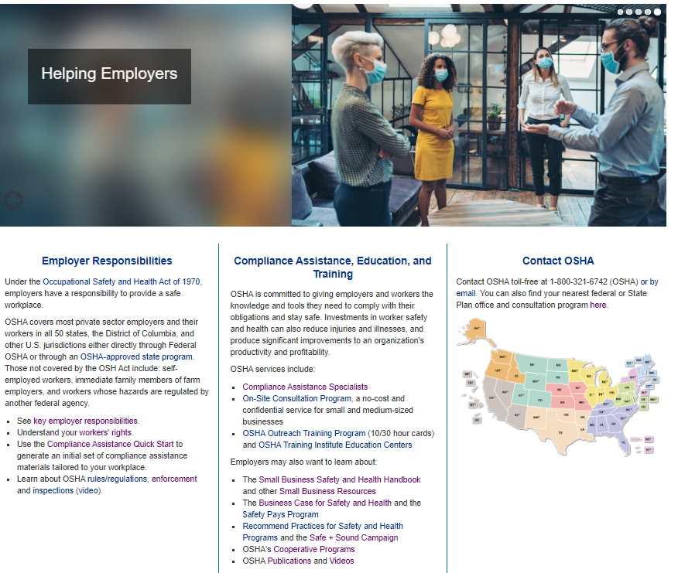
Employer Responsibilities
Provide a workplace free from serious recognized hazards (OSH Act general duty clause)
Comply with applicable OSHA standards
Provide safety training required by OSHA standards in a way that workers can understand
Post the OSHA poster, report fatalities and severe injuries, and comply with injury/illness recordkeeping requirements
www.osha.gov/employers
Notes:
These are some of an employer’s key responsibilities under the Occupational Safety and Health Act.

Slide 8
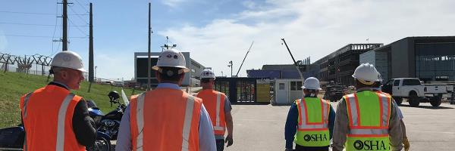
OSHA Enforcement
OSHA sets enforcement policy and targeted inspection programs, and responds to fatalities, catastrophes and complaints.

Slide 9
Inspections by Federal OSHA
Notes:
This chart shows the number of inspections conducted by federal OSHA over the years. The number for FY2022 is 31,820
[See FY 2022 Annual Enforcement Summary: https://www.osha.gov/enforcement/2022-enforcement-summary]

Slide 10
Inspection Types
Unprogrammed inspections
Programmed inspections
Notes:
OSHA conducts enforcement activities through two different inspection types – unprogrammed and programmed.
Programmed inspections specifically target the most dangerous workplaces and the most recalcitrant employers.
Unprogrammed inspections are initiated for several reasons, including worker complaints, referrals, employer reports and follow-up inspections.

Slide 11
Unprogrammed Activity
Imminent Danger
Fatality/Catastrophe
Complaints/Referrals
!
Notes:
Approximately 57% of OSHA inspections in FY 2021 were for unprogrammed activity
Unprogrammed activity has higher priority than programmed activity.
Unprogrammed activity includes imminent danger situations, fatalities and catastrophes, and complaints and referrals.
The highest priority goes to activity involving an imminent danger situation. This is where there is a high likelihood for a fatality or serious injury if the hazard is not addressed.
The next priority situation is where a worker has died or been hospitalized. OSHA would initiate an inspection to determine how the incident occurred, and to address the hazard before anyone else is killed or injured.
Inspections would also be conducted for formal employee complaints, or referrals, that involve serious hazards.
If a complaint involves a situation that is considered “other-than-serious”, OSHA would allow the employer to conduct a self-investigation and respond back with the results. The same process is used if the complaint comes from a former employee.
One type of employer-based referral comes from a severe injury report.
In 2015, OSHA expanded the list of work-related severe injuries that employers must report to the agency. Employers already had to report all work-related fatalities and hospitalizations of three or more employees within eight hours. Now, employers must also report all work-related in-patient hospitalizations, amputations, and loss of an eye to OSHA within 24 hours.
The Severe Injury Reporting program typically results in approximately 200 employer reports per week. OSHA inspects about one third of those reports. (In CY 2022 the Federal OSHA numbers were SIRs = 10,378 with 31% inspected.)

Slide 12
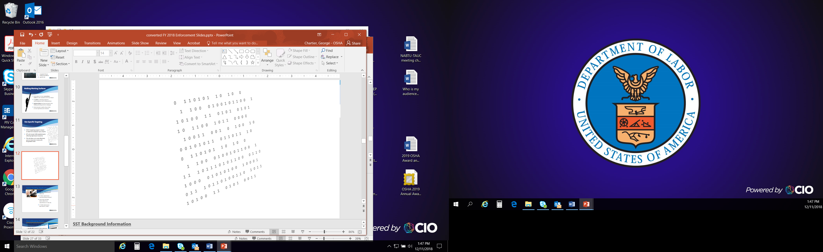
Programmed Activity
Special Emphasis Programs
Site-Specific Targeting
Notes:
Programmed inspections result from special emphasis programs and site-specific targeting.
Emphasis Programs focus on outreach and inspection efforts on specific hazards or industries. They are conducted at the National, Regional, or Local level depending on where the hazards are most prevalent.
National Emphasis Programs provide for programmed inspections of establishments in industries with potentially high injury or illness rates.
Local and Regional Emphasis Programs are enforcement strategies intended to address hazards or industries that pose a particular risk to workers in that office's jurisdiction.
The Site-Specific Targeting Program is OSHA’s main inspection plan for non-construction workplaces that have 20 or more employees.
The Site-Specific Targeting Program directs enforcement resources to those workplaces with the highest rates of injuries and illnesses. OSHA uses illness and injury information submitted by employers to determine when and where to use this program.

Slide 13
The Inspection Process
Opening Conference
Walkaround
Closing Conference
Contest/Resolution
Notes:
OSHA’s on-site inspection begins with the compliance officer showing his or her credentials. This leads into an opening conference, which is a meeting between the OSHA inspector and the employer representative.
The compliance officer will explain why OSHA selected the workplace for inspection, and explain the inspection process. They will describe the scope of the inspection, walkaround procedures, employee representation, and the process for employee interviews.
Following the opening conference, the compliance officer and the representatives will walk through portions of the workplace covered by the inspection. This is called the walkaround. During the walkaround, they will look for hazards that could lead to worker injury or illness.
After the walkaround, the compliance officer will hold a closing conference with the employer and the employee representative to discuss the findings.
When an inspector finds violations of OSHA standards or serious hazards, OSHA may issue citations and fines.
A citation includes methods an employer may use to fix a problem and the date by which they must do so. Employers have the right to contest any part of the citation, including whether a violation actually exists. Workers only have the right to challenge the deadline by which a problem must be resolved.
Appeals of citations are heard by the independent Occupational Safety and Health Review Commission (OSHRC).

Slide 14
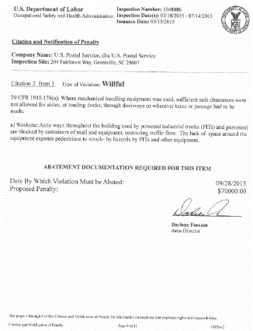
Violation Elements
Applicable Standard
Existence of Hazard
Exposure to Hazard
Employer Knowledge
Notes:
To prove that a violation has occurred, OSHA has to prove four elements:
--That an applicable standard exists
--That a hazard existed
--That an employee was exposed to the hazard, and
--That the employer knew, or should have known of the violation.
Citations are reviewed and issued at the Area Office Level. However, some types of citations or inspection scenarios might require a higher level of review.
OSHA has six months to issue a citation.

Slide 15
Violation Classification
Other-than-Serious
Serious
Repeated
Willful
Failure to Abate
Notes:
There are five main types of violations issued by OSHA. They are serious, other-than-serious, repeated, willful, and failure to abate. Let’s walk through each of those.
Other-than-Serious Violations
Other-than-Serious violations are issued when the most likely result from a hazardous condition would probably not be death or serious physical harm. These violations would, however, have a direct and immediate impact on the safety and health of employees.
Serious Violations
Serious violations are issued if it is probable that death or serious physical harm could result.
A determination must also be made that it is a recognized hazard. This is often determined on the basis of employer or industry recognition of the hazard.
Repeated Violations
Repeated violations are issued if an employer has been cited previously for the same or a substantially similar hazard.
This only applies if the previous citation has become a final order. A citation may become a final order when an employer does not contest the citation, or by a court decision or settlement.
The previous citation must have become a final order before the occurrence or observation of the second violation.
Willful Violations
Willful violations are issued when an employer has demonstrated either intentional disregard for the law, or plain indifference to worker safety and health.
Failure to Abate Violations
Failure to abate violations are issued when a previously cited violation has not been corrected.
However, if the violation was corrected, but later reoccurs, the subsequent violation is not considered a failure to abate. It would be deemed a repeated violation.
Test Question:
22. OSHA must issue a citation within ___ of the occurrence of the violation: (TLO 5)
Three months
Six months
Twelve months
Five years
23. Citations are signed by the OSHA Area Director but they are not effective until they become a final order of: (TLO 5)
The Assistant Secretary for OSHA
The Occupational Safety and Health Review Commission
The Solicitor of Labor
The Secretary of Labor

Slide 16
Top 10 Violations: FY 2022
Most frequently cited OSHA standards during FY 2022 inspections:
Fall Protection – General Requirements (1926.501)
Hazard Communication (1910.1200)
Ladders (1926.1053)
Respiratory Protection (1910.134)
Scaffolding (1926.451)
Lockout/Tagout (1910.147)
Powered Industrial Trucks (1910.178)
Fall Protection – Training Requirements (1926.503)
Eye and Face Protection (1926.102)
Machine Guarding (1910.212)
www.osha.gov/top10citedstandards
Notes:
This is a PRELIMINARY list of the top 10 most frequently cited standards following inspections of worksites by federal OSHA in FY 2022. It is based on OIS data pulled 1-11-2023 and will almost certainly change. Inspection data for FY 2022 will not be considered final until April 2023. So far, though, it is the same 10 standards as it was in FY 2021, just in a different order.
[Note to presenters:. More detailed PPTs on Top 10 Violations in various industries are available on the O drive under DCSP/CAS Resources/Presentations/Top 10 Violations/.]

Slide 17

Top 10 Violations in FY 2022
Most frequently cited OSHA standards during FY 2022 construction inspections:*
Fall Protection – General Requirements (1926.501)
Ladders (1926.1053)
Scaffolding (1926.451)
Fall Protection – Training (1926.503)
Eye and Face Protection (1926.102)
Head Protection (1926.100)
General Safety and Health Provisions (1926.20)
Aerial Lifts (1926.453)
Specific Excavation Requirements (1926.651)
Fall Protection – Systems Criteria and Practices (1926.502)
Notes:
This is a PRELMINARY list of the top 10 most frequently cited OSHA standards during inspections of construction worksites in FY 2022.
[Note to presenters: This list is based on data pulled from OIS on 01/11/2023 (OIS Standards Cited Report: All Fed RIDS, Industry Sector: Construction, Issuance Dates: 10/1/2021-9/30/2022; Std Part and Sect) and is subject to change.
More detailed PPTs on Top 10 Violations in various industries are available on the O drive under DCSP/CAS Resources/Presentations/Top 10 Violations/.]

Slide 18
Top Ten Violations in General Industry
FY 2022
Respiratory Protection (1910.134)
Hazard Communication (1910.1200)
Powered Industrial Trucks (1910.178)
General Requirements, Electrical (1910.303)
Control of Hazardous Energy, Lockout/Tagout (1910.147)
6. Wiring methods, components, and equipment for general use (1910.305)
7. Maintenance, safeguards, and operational features for exit routes (1910.37)
8. General Requirements, Personal Protective Equipment (1910.132)
9. Portable Fire Extinguishers (1910.157)
10. Healthcare (1910.502)
Notes:
This is a preliminary list of the top 10 most frequently cited standards following inspections of general industry worksites by federal OSHA in FY 2021.
OSHA uses the term "general industry" to refer to all industries not included in agriculture, construction or maritime.
NOTE: Final FY 2022 numbers are not available until April 2023. This top 10 list is based on data pulled 01/11/2023 (OIS Standards Cited Report: All Fed RIDS, Industry Sector: General Industry, Issuance Dates: 10/1/2020-9/30/2021, Standard Level: Std Part and Sect)

Slide 19
OSHA Penalty Levels: 2023
Type of Violation | New Maximum
Serious and Other-Than-Serious Posting Requirements | $15,625 per violation
Willful or Repeated | $156,259 per violation
Failure to Abate | $15,625 per day beyond the abatement date
www.osha.gov/penalties
Notes:
[Note to presenters: For a PPT on OSHA’s penalty levels, see the O drive at DCSP/CAS Resources/Presentations/Penalties/.]
Below are the maximum penalty amounts, with the annual adjustment for inflation, that may be assessed after Jan. 15, 2023.

Slide 20
Penalty Adjustment Factors
History
Good Faith
Size
Notes:
When setting a penalty, OSHA begins with the maximum penalty, then makes adjustments based on a variety of factors.
The Agency generally reduces penalties for small employers, those acting in good faith, and employers with no recent citations.
A 10% reduction may be given for employers who were inspected within the last five years with no serious violations. However, the penalty can be increased by 10% for companies that have been issued serious citations within the past five years.
A reduction of either 15% or 25% can be given to companies who demonstrate a good faith effort to address safety and health issues in the workplace.
And a reduction can be given for the company’s size (number of employees), up to 70% for companies with fewer than 11 employees.
Test Question:
22. OSHA must issue a citation within ___ of the occurrence of the violation: (TLO 5)
Three months
Six months
Twelve months
Five years
23. Citations are signed by the OSHA Area Director but they are not effective until they become a final order of: (TLO 5)
The Assistant Secretary for OSHA
The Occupational Safety and Health Review Commission
The Solicitor of Labor
The Secretary of Labor

Slide 21

Criminal Referrals
Criminal sanctions are
outlined in the OSH Act
To obtain a conviction,
a prosecutor must establish certain
conditions beyond a reasonable doubt
Notes:
The OSH Act also provides for a criminal penalty of up to six months in prison and a $10,000 fine if an employer’s willful violation of an OSHA standard causes the death of an employee.
When employers willfully neglect their responsibilities, OSHA responds with strong, decisive actions – including criminal referrals to the U.S. Department of Justice.
To obtain a conviction, there must be proof beyond a reasonable doubt that:
--the employer is engaged in a business affecting commerce;
--the employer violated a regulatory standard promulgated under the OSH Act;
--that the violation was willfully committed; and
--that the violation was a direct cause of an employee’s death.
In December 2015, the U.S. Department of Labor and the U.S. Department of Justice entered into a Memorandum of Understanding (MOU) to increase the frequency and effectiveness of criminal prosecutions.
The agreement establishes a process and framework for notification, consultation, and coordination between the two Departments.
As a result, the Department of Justice has directed U.S. attorneys to more aggressively consider criminal referrals from the Department of Labor.
U.S. attorneys also consider prosecution for false statements, retaliating against a witness, destruction or falsification of records, and other actions. Sanctions for these violations include criminal sentences of up to 20 years per charge, and penalties of $250,000 against individuals and $500,000 against corporations.
Test Question:
22. OSHA must issue a citation within ___ of the occurrence of the violation: (TLO 5)
Three months
Six months
Twelve months
Five years
23. Citations are signed by the OSHA Area Director but they are not effective until they become a final order of: (TLO 5)
The Assistant Secretary for OSHA
The Occupational Safety and Health Review Commission
The Solicitor of Labor
The Secretary of Labor

Slide 22

Electronically Submitting
Injury and Illness Data
Covered employers must electronically submit
data from the previous calendar year’s OSHA Form 300A using OSHA’s Injury Tracking Application by March 2
Applies to establishments with 250 or more
employees that are currently required to keep
OSHA injury and illness records, and establishments
with 20-249 employees that are classified in certain industries with historically high rates of occupational injuries and illnesses
www.osha.gov/injuryreporting
Notes:
ELECTRONICALLY SUBMITTING INJURY AND ILLNESS DATA
Covered employers must electronically submit data from their OSHA Form 300A to OSHA using OSHA’s Injury Tracking Application.
This rule applies to—
establishments with 250 or more employees that are currently required to keep OSHA injury and illness records, and
establishments with 20-249 employees that are classified in certain industries with historically high rates of occupational injuries and illnesses

Slide 23
Worker Rights
Employees have the right to:
Report unsafe conditions and injuries
to management or OSHA
Assist an OSHA investigation
Request Training
Request PPE
Act of Congress
OSH ACT
of 1970
www.osha.gov/workers
Notes:
WORKER RIGHTS
Protecting workers means not only complying with regulations. Workers also have a legal right to raise safety and health concerns on the job without fear of retaliation.
Among other protections, workers have the right to—
report unsafe working conditions to their managers and to OSHA;
assist in an OSHA investigation; and
request Personal Protective Equipment (PPE) and training to make sure that they can do their jobs without exposure to hazards that can cause injury or illness.

Slide 24
Whistleblower Protections
Employers cannot retaliate against workers who exercise their rights.
Retaliation includes:
  Reduction in pay or hours
  Being fired, laid off, or suspended
  Reassignment, discipline, or demotion
  Threats, harassment, and intimidation
  Blacklisting from hiring
Whistleblowers.gov
Notes:
WHISTLEBLOWER PROTECTIONS
It is against the law for employers to discipline or suspend their workers for reporting injuries or exercising other rights—and OSHA enforces this law.
Retaliation can include reducing pay or hours; firing, laying off or suspending workers; reassignment, discipline, or demotion; threats, harassment, or intimidation; and blacklisting from hiring.
It is well known that companies with effective safety and health programs actually find it helpful to encourage employees to report their concerns.
Think about it: Would you rather hear about a potential problem from your employee, or from a government inspector? Or, worse, not hear about it at all, and then suffer a mishap, an injury, or even a fatality?
[Insert your own local whistleblower protection story.]
When a worker brings a hazard or concern to a supervisor’s attention, the supervisor should welcome the worker’s comment, thank the worker for showing initiative, and, after the hazard has been managed, praise the worker in the presence of others to encourage more worker engagement in finding and fixing problems before workers get hurt.

Slide 25
Compliance Assistance
OSHA helping employers:
23 million visitors to OSHA’s website in FY 2022
300,500 responses to OSHA 1-800 calls for help
11,700 e-mail requests for assistance answered
6,200 outreach activities by Regional & Area Offices
20,100 small businesses helped through Consultation

Slide 26

Compliance Assistance Specialists
Work out of OSHA’s Area Offices
Provide general information about OSHA’s standards and compliance assistance resources
Available for seminars, workshops, and speaking events
www.osha.gov/complianceassistance/cas
Notes:
OSHA’s Compliance Assistance Specialists (CASs) implement OSHA’s outreach initiatives around the country.
There is one CAS in most OSHA Area Offices. A directory of CASs is available on the OSHA webpage.
Note that CASs do not perform On-site Consultation visits. To request On-site Consultation assistance, contact your state On-site Consultation Project.

Slide 27
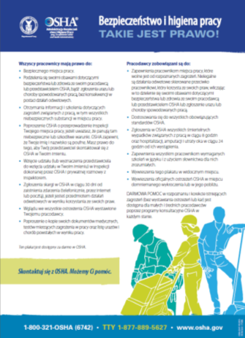
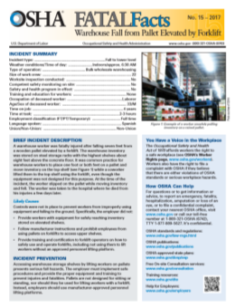



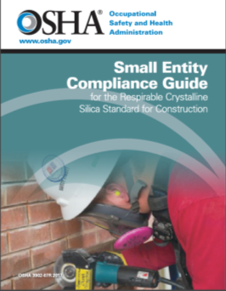




OSHA publications
for every workplace training need
osha.gov/publications
Notes:
OSHA PUBLICATIONS
Examining ways to improve the accessibility of information about available resources is a key project for OSHA. As new products are developed or updates of existing resources occur, a primary consideration is to carefully consider the varied audiences, and how they can best access and use our materials.
This approach applies to all the materials that the agency is creating for including in the web portal. Please let us know if there are materials you would like to see from us. Your input is welcome and appreciated; after all, these resources are created to help all of our stakeholders – particularly both employers and workers.

Slide 28
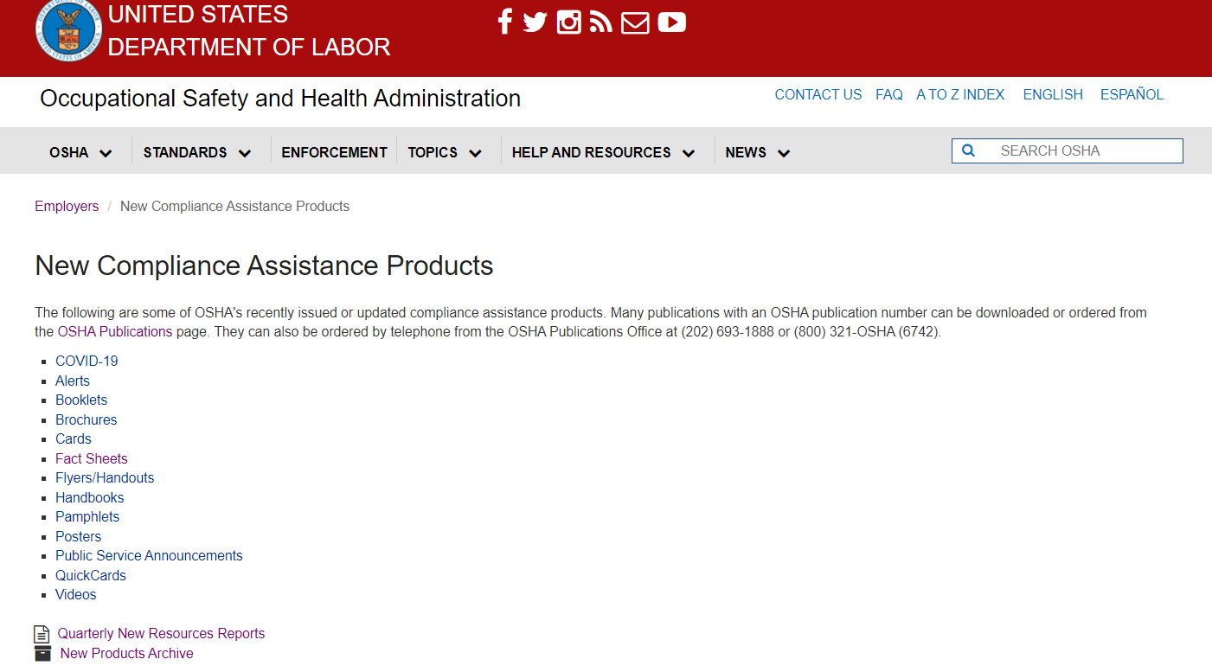
New Compliance Assistance Resources
www.osha.gov/complianceassistance/new-ca-products
Notes:
[Note to presenters: For a PPT on new resources from OSHA and other organizations, see the O drive at DCSP/CAS Resources/Presentations/New OSHA Resources/.]
This webpage includes a continually updated listing of new OSHA resources.

Slide 29
OSHA On-Site Consultation Program
No cost to employers
Separate from enforcement
and confidential
Identifies workplace hazards
Advises on compliance with OSHA standards
Helps employers establish safety and health programs
More than 796,500 workers removed from hazards in FY 2022
osha.gov/consultation
Notes:
[Note to presenters: For a PPT on OSHA’s small business resources, see the O drive at DCSP/CAS Resources/Presentations/Small Businesses/.]
One OSHA program that we encourage you to promote to your small business clients is the On-Site Consultation Program.
OSHA’s On-Site Consultation services are available to all private sector small and medium-sized businesses at no cost to employers.
OSHA defines “small businesses as those businesses with less than 250 employees at one work location or no more than 500 employees corporate wide.
Small businesses in high hazard industries receive priority for Consultation services..
Consultation services are provided to small businesses in all 50 states, the District of Columbia, and several U.S. territories by On-Site Consultation programs located and operated from within state agencies or universities.
On-Site Consultation programs are separate from OSHA’s enforcement and do not issue penalties or citations. On-Site Consultation services are voluntary and provided at the request of employers.
Small businesses will benefit greatly from On-Site Consultation services: workers, managers, and the business as a whole will experience positive outcomes.
Businesses that use Consultation services often improve their bottom lines as they engage their workers in all aspects of workplace safety and health. Benefits to businesses include::
Lowering injury and illness rates;
Decreasing workers' compensation costs;
Reducing lost workdays; and
Limiting equipment damage and product losses.

Slide 30





Cooperative Programs
Alliance Program
OSHA Strategic Partnership Program
Voluntary Protection Programs (VPP)
OSHA Challenge
On-Site Consultation Program & Safety and Health Recognition Program (SHARP)
Notes:
[Note to presenters: For PPTs on OSHA’s cooperative programs, see the O drive at DCSP/CAS Resources/Presentations/Cooperative Programs/.]
OSHA offers cooperative programs under which businesses, labor groups, and other organizations can work cooperatively with the Agency to help prevent fatalities, injuries, and illnesses in the workplace.
Alliance Program. Through the Alliance Program, OSHA works with groups committed to worker safety and health to prevent workplace fatalities, injuries, and illnesses. These groups include unions, consulates, trade or professional organizations, businesses, faith- and community-based organizations, and educational institutions. OSHA and the groups work together to develop compliance assistance tools and resources, share information with workers and employers, and educate workers and employers about their rights and responsibilities. Alliance Program participants do not receive exemptions from OSHA inspections or any other enforcement benefits.
OSHA Strategic Partnership Program (OSPP). The OSPP provides the opportunity for OSHA to partner with employers, workers, professional or trade associations, labor organizations, and/or other interested stakeholders. OSHA Strategic Partnerships (OSP) are formalized through unique agreements designed to encourage, assist, and recognize partner efforts to eliminate serious hazards and achieve model workplace safety and health practices. Each OSHA Strategic Partnership establishes specific goals, strategies, and performance measures to improve worker safety and health. OSP models include those focused on improving safety and health in major corporations/government agencies, at large construction projects, and for entire industries. The OSPP is available to private sector industries and government agencies in locales where OSHA has jurisdiction.
Voluntary Protection Programs (VPP). The VPP recognize employers and workers in the private industry and federal agencies who have implemented effective safety and health management systems and maintain injury and illness rates below national Bureau of Labor Statistics averages for their respective industries. In VPP, management, labor, and OSHA work cooperatively and proactively to prevent fatalities, injuries, and illnesses through a system focused on: hazard prevention and control; worksite analysis; training; and management commitment and worker involvement. To participate, employers must submit an application to OSHA and undergo a rigorous onsite evaluation by a team of safety and health professionals. Union support is required for applicants represented by a bargaining unit. VPP participants are re-evaluated every three to five years to remain in the programs. VPP participants are exempt from OSHA programmed inspections while they maintain their VPP status.
OSHA Challenge. Launched in 2004 as a pilot program, OSHA Challenge provides interested employers and workers the opportunity to gain assistance in improving their safety and health management systems. Challenge Administrators experienced in safety and health guide Challenge Participants through a three-stage process to implement an effective system to prevent fatalities, injuries, and illnesses. An on-line tool is provided which breaks down the actions, documentation, and results desired. Graduates of OSHA Challenge receive recognition from OSHA as they incrementally improve their safety and health management systems. OSHA Challenge is available to general industry and construction employers in the private and public sectors under OSHA’s federal jurisdiction.
On-Site Consultation Program. OSHA’s On-Site Consultation Program offers no-cost and confidential advice to small and medium-sized businesses in all states across the country, with priority given to high-hazard worksites. On-Site Consultation services are separate from enforcement and do not result in penalties or citations. Consultants from state agencies or universities work with employers to identify workplace hazards, provide advice on compliance with OSHA standards, and assist in establishing safety and health management systems.
Safety and Health Achievement Recognition Program (SHARP). Employers that have a full On-site Consultation visit and meet other requirements may be recognized under SHARP for their exemplary safety and health management systems. Worksites that receive SHARP recognition are exempt from programmed inspections during the period that the SHARP certification is valid.

Slide 31
OTI Education Centers
Over 50 courses available in construction, general, and maritime industries
  covers OSHA standards, recordkeeping, LOTO, machine guarding, confined space entry, fall protection and Outreach train-the-trainer
OTI Education Centers annually train over 55,000 students in over 4,500 classes
www.osha.gov/OTIEC
Notes:
Support for OSHA Initiatives
The OTI Education Center Program is an integral resource in supporting OSHA’s training objectives. Since the creation of the program in 1992, the OTI Education Centers have advanced occupational safety and health training, and supported OSHA’s mission. The OTI Education Centers continue to play a vital role in furthering our national training and education objectives. OSHA will continue to expand training and educational opportunities for students in the program as OSHA endeavors to promote occupational safety and health in the workplace, reduce injury and illnesses, and save lives.
OTI Education Centers collaborate with their Regional and Area Offices to support emphasis programs through marketing, communication, and training efforts. OTI Education Centers consistently promote and support OSHA campaigns such as Safe+Sound, Heat Stress, Excavation and Trenching, and the National Safety Stand Down to Prevent Falls in Construction. Many OTI Education Centers offer reduced or no cost training in support of OSHA campaigns.
Course Offerings
The OTI Education Centers provide training nationwide to public and private sector and federal personnel from agencies outside OSHA. Courses currently available through the OTI Education Centers include the most popular ones such as the #500 Trainer Course in Occupational Safety and Health Standards for the Construction Industry and #501 Trainer Course in Occupational Safety and Health Standards for General Industry. These "train the trainer" courses support the OSHA Outreach Training Program, which is the agency's primary way to train workers in the basics of occupational safety and health. By increasing the number of OSHA Outreach Trainer courses available, the OTI Education Centers have been a catalyst in the rapid growth of the Program, which now has a trainer list numbering over 42,000. Last year, over 1 million students were trained through the Outreach Training Program.
Other OTI Education Center course offerings address topics in the construction, general, and maritime industries including; hazardous materials, machine guarding, ergonomics, confined space, excavation, electrical standards and fall protection. There are currently a number of one-day short courses in subject areas such as safety and health management, recordkeeping, silica, safe patient handling, lock-out/tag-out, and fall awareness. These are being added to meet the needs of students who are unable to attend the full-week courses, but would like to benefit from the OSHA training curriculum.

Slide 32
FY 2023 Outreach Events
Stand-Up 4 Grain Safety Week (March 27-31, 2023)
Heat Illness Prevention Campaign (Spring-Fall 2023)
National Work Zone Awareness Week (Apr. 17-21, 2023)
Fall Prevention Stand-Down (May 1-5, 2023)
Safe + Sound Week (August 7-13, 2023)
Suicide Prevention Awareness Month (Sept. 2023)
Notes:
Here’s an updated listing of OSHA’s key outreach initiatives for FY 2023.

Slide 33
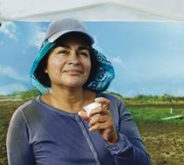


Heat Illness Prevention Campaign
Heat illness sickens thousands and results in the deaths of dozens of workers each year
Campaign educates employers and workers on danger of working in heat
Campaign complements OSHA heat rulemaking and enforcement, including a National Emphasis Program
OSHA Heat Illness Prevention Campaign
English Spanish
www.osha.gov/heat
Notes:
In addition to OSHA’s continued outreach on heat illness prevention:
On September 1, 2021, OSHA established a new enforcement initiative to prevent heat-related illnesses and fatalities for those working in hazardous hot indoor and outdoor environments. OSHA will prioritize heat-related enforcement efforts on heat priority days (i.e., days when the heat index exceeds 80°F) for a variety of indoor and outdoor industries, with the aim of identifying and mitigating potential hazards and preventing heat-illnesses before they occur.
On October 27, 2021, OSHA initiated rulemaking to protect indoor and outdoor workers from hazardous heat by issuing an Advanced Notice of Proposed Rulemaking (86 FR 59309). The agency sought comments about the extent and nature of hazardous heat in the workplace and the nature and effectiveness of interventions and controls used to prevent heat-related injury and illness. The comment period was extended through January 26, 2022.
OSHA also issued a National Emphasis Program (NEP) on heat hazard cases that targets high-risk industries and focus OSHA resources and staff time on heat inspections.
Within OSHA’s National Advisory Committee on Occupational Safety and Health (NACOSH), OSHA is forming a Heat Illness Prevention Work Group to provide better understanding of challenges and best practices in protecting workers from heat hazards. OSHA will convene periodic meetings of the work group to provide diverse perspectives on topics including identification, monitoring, and response to workplace heat hazards; heat emergency response plans; and worker training and engagement.

Slide 34

Fall Prevention Campaign
FALLS are the leading cause
of deaths in construction —
>38% of all construction fatalities
In 2021, there were 378 fatal falls to a lower level out of 986 construction fatalities
Millions of employers and workers participate in annual National Safety Stand-Down to prevent falls events nationwide
www.osha.gov/stopfalls
Notes:
STOP FALLS: FALL PREVENTION CAMPAIGN
The Fall Prevention Campaign continues to be one of the agency’s major initiatives.
Falls remain the leading cause of worker fatalities in the construction industry. Fall protection and education also continues to be in OSHA’s top ten cited regulations.
To help raise awareness and encourage the prevention of falls, each year the agency, in coordination with NIOSH, CPWR, and the National Occupational Research Agenda council hosts a National Fall Safety Stand-Down. These events have reached nearly 10 million workers.

Slide 35

Suicide Prevention Awareness
Suicide is a complex public health problem that deeply impacts workers, their families, and our communities.
Worker suicides are especially high among construction workers, due in part to work-related stresses such as seasonal work, demanding schedules, and workplace injuries.
OSHA published a poster, “Suicide Prevention: 5 Things You Should Know” and has a national alliance with the American Foundation for Suicide Prevention.
The agency continue to support Suicide Prevention Awareness Month in September.
www.osha.gov/preventingsuicides
Notes:
Work-related stress can have a severe impact on mental health and, without proper support, lead to suicide.
Worker suicides are particularly concerning for the construction industry. The suicide rate for construction workers is 4 times higher than in the general population, due in part to work-related stresses such as seasonal work, demanding schedules and workplace injuries.
OSHA published a poster, “Suicide Prevention: 5 Things You Should Know” that is available in English and Spanish.
OSHA has a national alliance with the American Foundation for Suicide Prevention.
OSHA is expanding outreach in this area, and will support Suicide Prevention Awareness Month in September 2023

Slide 36
Protecting Temporary Workers:
A joint responsibility
Both host employers and staffing agencies have roles in complying with workplace health and safety requirements and they share responsibility for ensuring worker safety and health.
Legally, both the host employer and the staffing agency are employers of the temporary worker.
Shared control over worker = Shared responsibility for worker

Slide 37
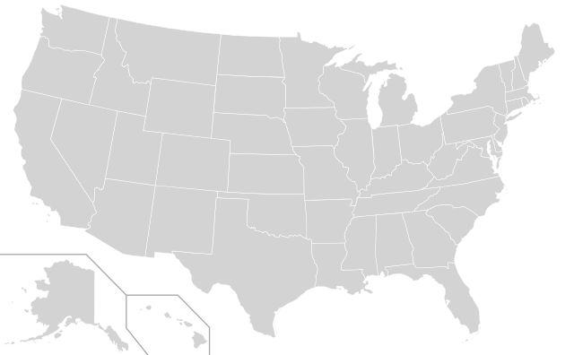
Temporary Workers
2.7 million people are employed by staffing companies every week.
14 million temporary and contract employees are hired by U.S. staffing firms over the course of a year.
Source: American Staffing Association, 2021

Slide 38
Why Are Temp Workers At High Risk of Injury?
New workers are at increased risk of injury.
Host employers don’t have the same commitment to temporary employees as to permanent ones.
Employer who bears the risk of the injury (temp agency) does not control safety and health investment.

Slide 39
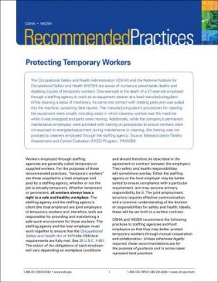
Temporary Workers:
Outreach & Education
Temporary Worker Recommended Practices
Series of Temporary Worker Initiative Bulletins
Alliance with American Staffing Association
www.osha.gov/temporaryworkers

Slide 40


Protecting Young Workers
Workers of all ages have rights to safe workplaces:
to raise concerns about hazards without fear of retaliation
to receive training and PPE
to ask questions if something seems unsafe
www.osha.gov/youngworkers
#MySafeSummerJob
OSHA: Young Workers’ Rights (Spanish)
OSHA: Young Workers’ Rights (English)
Notes:
PROTECTING YOUNG WORKERS
Every minute a young worker (age 15-25) is injured on the job and every day one young worker loses their life in a preventable workplace incident.
OSHA has resources including a webpage and a video (available in English and Spanish), to help deliver the message that workers of all ages have the right to a safe workplace.
Those rights include the right to ask questions if something seems unsafe, the right to report unsafe conditions without the fear of retaliation, and the right to receive training and protective gear.
OSHA has partnered with worker safety organizations on #MySafeSummerJob, a social media campaign to educate young workers about their rights in the workplace, how to speak up about dangerous work conditions, and how to protect themselves on the job.
Stakeholders joined OSHA, the U.S. Department of Labor's Wage and Hour Division, and others over five weeks– April 15 through May 17, 2021 – to promote safety among young workers.
The campaign aimed to bring awareness to youth, educators, parents, supervisors, and employers about the importance of workplace safety.
Working together, we can increase hazard awareness and avoidance skills, and empower youth with knowledge of their workplace rights and responsibilities. We can teach them how to speak up about dangerous work conditions and how to protect themselves on the job. Together, we can prevent injuries, avoid illnesses, and save lives.

Slide 41
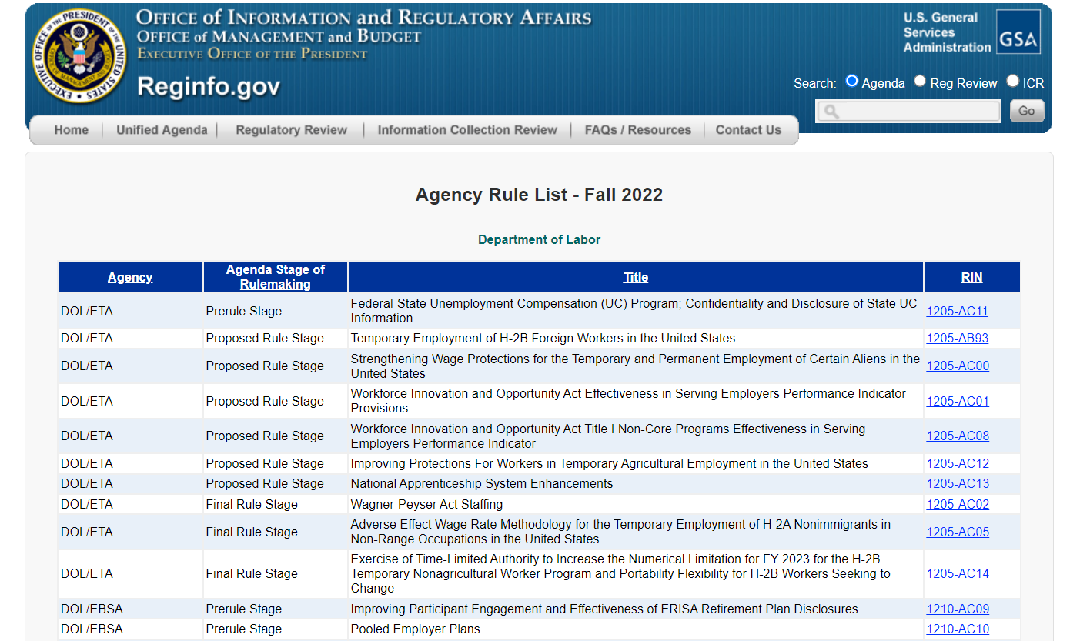
OSHA Rulemaking
See the Regulatory Agenda for the status of OSHA’s rulemaking (www.reginfo.gov)
www.reginfo.gov
Notes:
[Note to presenters: A PPT on OSHA’s Regulatory Agenda is available on the O drive under DCSP/CAS Resources/Presentations/Reg Agenda/.]
The following slides review some of the major rules that OSHA has issued in recent years.

Slide 42
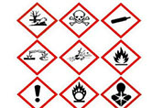
Final Rule Stage:
Hazard Communication Standard
This rulemaking will:
  Harmonize the HCS to the latest edition of the Globally Harmonized System of Classification and Labeling of Chemicals (GHS), and
  Codify enforcement policies OSHA has issued since the 2012 standard.
Notes:
OSHA and other U.S. agencies have been involved in a long-term project to negotiate a globally harmonized approach to classifying chemical hazards, and providing labels and safety data sheets for hazardous chemicals. The result is the Globally Harmonized System of Classification and Labeling of Chemicals (GHS). The GHS was adopted by the United Nations, with an international goal of as many countries as possible adopting it by 2008.
OSHA incorporated the GHS into the Hazard Communication Standard (HCS) in March 2012 to specify requirements for hazard classification and to standardize label components and information on safety data sheets, which will improve employee protection and facilitate international trade. However, the GHS is a living document and has been updated several times since OSHA’s rulemaking.
While OSHA's HCS 2012 was based on the third edition of the GHS, OSHA’s current rulemaking is to harmonize the HCS to the seventh edition of the GHS, improve harmonization with international trading partners such as Canada, and to codify a number of enforcement policies that have been issued since the 2012 standard.
Note that this rulemaking will adopt the seventh edition; however, the UN is already up to the nineth.

Slide 43
Final Rule Stage:
Workplace Injury/Illness Tracking
OSHA restored the requirement to electronically submit to OSHA information from the OSHA Form 300 and OSHA Form 301.
Final Rule issued July 2023 and becomes effective January 1, 2024.
Notes:
OSHA restored provisions of the Improve Tracking of Workplace Injuries and Illnesses final rule, 81 FR 29624 that were removed by Tracking of Workplace Injuries and Illnesses final rule, 84 FR 380 (January 25, 2019).
OSHA amended its recordkeeping regulation to restore the requirement to electronically submit to OSHA information from the OSHA Form 300 (Log of Work-Related Injuries and Illnesses) and OSHA Form 301 (Injury and Illness Incident Report) for establishments that meet certain size and industry criteria. Under the current regulation, these establishments are required to electronically submit information only from the OSHA Form 300A (Summary of Work-Related Injuries and Illnesses).
The Final Rule to Improve Tracking of Workplace Injuries and Illnesses was published in the Federal Register (https://www.federalregister.gov/documents/2023/07/21/2023-15091/improve-tracking-of-workplace-injuries-and-illnesses) on July 21, 2023.
Final rule becomes effective January 1, 2024

Slide 44
OSHA: Proposed Rule Stage
Infectious Diseases
Cranes and Derricks in Construction Amendments
Communication Towers
Emergency Response
Tree Care
Welding in Construction Confined Spaces
PPE in Construction
Powered Industrial Truck Design Standard Update
Walking Working Surfaces
Silica- Medical Surveillance Provisions Revisions
Worker Walkaround Representative Designation Process
Notes:
This slide lists items in the Proposed Rule Stage. The following slides provide more detail on each of these items.

Slide 45
Proposed Rule Stage: Infectious Diseases
Employees in health care and other high-risk environments face long-standing infectious disease hazards
OSHA is examining regulatory alternatives for control measures to protect employees from infectious disease exposures to pathogens that can cause significant disease.
Proposed Rule expected in March 2024.
Notes:
Employees in health care and other high-risk environments face long-standing infectious disease hazards such as tuberculosis (TB), varicella disease (chickenpox, shingles), and measles, as well as new and emerging infectious disease threats, such as Severe Acute Respiratory Syndrome (SARS), the 2019 Novel Coronavirus (COVID-19), and pandemic influenza. Health care workers and workers in related occupations, or who are exposed in other high-risk environments, are at increased risk of contracting TB, SARS, Methicillin-Resistant Staphylococcus Aureus (MRSA), COVID-19, and other infectious diseases that can be transmitted through a variety of exposure routes.
OSHA is examining regulatory alternatives for control measures to protect employees from infectious disease exposures to pathogens that can cause significant disease.
Workplaces where such control measures might be necessary include: health care, emergency response, correctional facilities, homeless shelters, drug treatment programs, and other occupational settings where employees can be at increased risk of exposure to potentially infectious people.
A standard could also apply to laboratories, which handle materials that may be a source of pathogens, and to pathologists, coroners' offices, medical examiners, and mortuaries.

Slide 46

Proposed Rule Stage: Cranes and Derricks in Construction
OSHA is proposing various corrections and amendments to the cranes and derricks standards issued in 2010.
Proposed Rule expected in March 2024.
Notes:
OSHA is proposing corrections and amendments to the final standard for cranes and derricks published in August 2010.
The standard has a large number of provisions designed to improve crane safety and reduce worker injury and fatality.
The proposed amendments:
correct references to power line voltage for direct current (DC) voltages as well as alternating current (AC) voltages;
broaden the exclusion for forklifts carrying loads under the forks from "winch or hook" to a "winch and boom";
clarify an exclusion for work activities by articulating cranes;
provide four definitions inadvertently omitted in the final standard;
replace "minimum approach distance" with "minimum clearance distance" throughout to remove ambiguity;
clarify the use of demarcated boundaries for work near power lines;
correct an error permitting body belts to be used as a personal fall arrest system rather than a personal fall restraint system;
replace the verb "must" with "may" used in error in several provisions;
correct an error in a caption on standard hand signals; and
resolve an issue of "NRTL-approved" safety equipment (e.g., proximity alarms and insulating devices) that is required by the final standard, but is not yet available.

Slide 47

Proposed Rule Stage:
Emergency Response
OSHA is considering updating its standards that address emergency preparedness and response.
Existing OSHA standards do not:
  Address the full range of hazards or concerns facing emergency responders,
  Reflect major developments in safety and health practices that have been incorporated into industry consensus standards.
  Reflect major changes in performance specifications for protective clothing and equipment.
Proposed Rule expected in November 2023.
Notes:
OSHA currently regulates aspects of emergency response and preparedness; some of these standards were promulgated decades ago, and none were designed as comprehensive emergency response standards. Consequently, they do not address the full range of hazards or concerns currently facing emergency responders, and other workers providing skilled support, nor do they reflect major changes in performance specifications for protective clothing and equipment.
The agency acknowledges that current OSHA standards also do not reflect all the major developments in safety and health practices that have already been accepted by the emergency response community and incorporated into industry consensus standards.
OSHA is considering updating these standards with information gathered through an RFI and public meetings.
OSHA held stakeholder meetings in July 2014 and convened a NACOSH working group in 2015-2016.
OSHA initiates the Small Business Regulatory Enforcement Fairness Act (SBREFA) process in August 2021, and intended to finalize it in December 2021.

Slide 48

Proposed Rule Stage:
Tree Care Standard
There is no OSHA standard for tree care operations; the agency currently applies a patchwork of standards to address the serious hazards in this industry.
The tree care industry previously petitioned the agency for rulemaking.
OSHA issued an advanced notice of proposed rulemaking (ANPRM) in September 2008 and completed a Small Business Regulatory Enforcement Fairness Act (SBREFA) panel in May 2020.
Proposed Rule expected in December 2023.
Notes:
There is no OSHA standard for tree care operations; the agency currently applies a patchwork of standards to address the serious hazards in this industry.
The tree care industry previously petitioned the agency for rulemaking and OSHA issued an ANPRM (September 2008).
OSHA completed a Small Business Regulatory Enforcement Fairness Act (SBREFA) panel in May 2020, collecting information from affected small entities on a potential standard, including the scope of the standard, effective work practices, and arboricultural specific uses of equipment to guide OSHA in developing a rule that would best address industry safety and health concerns.
Tree care continues to be a high-hazard industry.

Slide 49
Proposed Rule Stage: Welding in Construction Confined Spaces
OSHA is proposing to amend the Welding and Cutting Standard in construction to eliminate any perceived ambiguity about the definition of "confined space" that applies to welding activities in construction.
Notes:
OSHA is proposing to amend the Welding and Cutting Standard in construction to eliminate any perceived ambiguity about the definition of "confined space" that applies to welding activities in construction.
When OSHA published the final rule for Confined Spaces in Construction (May 4, 2015), a new subpart was added to provide protections to employees working in confined spaces in construction. This new subpart replaced OSHA's one training requirement for confined space work with a comprehensive standard that includes a permit program designed to protect employees from exposure to many hazards associated with work in confined spaces, including atmospheric and physical hazards.
The explanation of the final rule also discusses in detail how the Welding and Cutting Standard in Construction works together with the confined spaces standard regarding the application of their respective requirements. Although the confined spaces standard states that it encompasses welding activities, the welding standard itself does not expressly identify a definition of "confined space".
OSHA will conduct a rulemaking to eliminate any perceived ambiguity about the definition of confined space that applies to welding activities in construction.

Slide 50
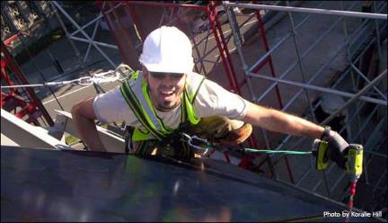
Proposed Rule Stage:
PPE in Construction
OSHA is planning to clarify requirements for the fit of PPE in construction.
Notes:
On December 6, 20212, OSHA issued a Request for Information (RFI) on Standards Improvement Project IV (SIP-IV), which aimed to reduce regulatory burdens while maintaining or enhancing worker safety and health.
On October 4, 2016, OSHA issued a Notice of Proposed Rulemaking (NPRM) pursuant to SIP-IV and proposed to add an explicit requirement for PPE used in construction to fit. The proposed regulatory text was similar to existing language in general industry and maritime PPE standards, and OSHA has always had an implicit requirement that PPE in construction must fit to be “adequate” and of “safe design.”
After OSHA received comments that this item required a rulemaking with a larger scope than SIP-IV; the agency withdrew the proposed language to propose it in a separate section
OSHA is requesting comments regarding the proposed revision by September 18, 2023
Proposed rule and comments was published in the Federal Register (https://www.federalregister.gov/documents/2023/07/20/2023-15285/personal-protective-equipment-in-construction) on July 20, 2023.

Slide 51

Proposed Rule Stage:
Powered Industrial Trucks – Design and Construction
OSHA’s is proposing to update the reference in its powered industrial trucks standard (1910.178) to incorporate by reference consensus standard provisions related to the design and construction of powered industrial trucks.
Notes:
OSHA is proposing to update its reference to the ANSI B56.1-1969 Safety Standard for Powered Industrial Trucks found in its powered industrial truck standards to also include the latest version of ANSI/ITSDF B56.1a-2018, Safety Standard for Low Lift and High Lift Trucks.
This rulemaking will incorporate by reference the consensus standard provisions related to the design and construction of powered industrial trucks.
This rulemaking is a continuation of OSHA’s ongoing effort to update references to consensus standards published by standards-developing organizations.
OSHA aims to improve worker safety and health by ensuring that consensus standards referenced in OSHA rules address current industry practice and state-of-the-art technology.
In a separate action (RIN 1218-AC99), OSHA is collecting information to evaluate the need to update requirements related to the maintenance and use of powered industrial trucks and training of operators.

Slide 52
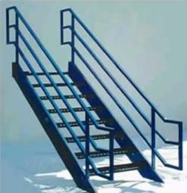
Proposed Rule Stage:
Walking-Working Surfaces
In response to feedback that some provisions of the 2016 final rule are unclear, OSHA plans to:
  Correct a formatting error in Table D-2 (Stairway Handrail Requirements), and
  Revise language on stair rail systems to make them clearer and reflect OSHA’s original intent.
Notes:
OSHA has received feedback from stakeholders indicating that several regulatory provisions of the 2016 final rule on Walking-Working Surfaces (81 FR 82494; November 18, 2016) are unclear.
The agency plans to correct a formatting error in Table D-2 (Stairway Handrail Requirements) and also revise the language of the requirements for stair rail systems to make them clearer and reflect OSHA's original intent.
The 2016 rule updated and revised the outdated general industry WWS and Personal Protective Equipment (Fall Protection Systems) standards on slip, trip, and fall hazards (29 CFR part 1910, subparts D and I). OSHA adopted the existing standards in 1971 and had not updated them since. The final rule also added new requirements on personal fall protection systems (29 CFR part 1910, subpart I).
OSHA plans to reopen the rulemaking record in August 2023.

Slide 53
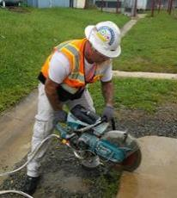
Proposed Rule Stage:
Silica - Medical Removal Protection
OSHA’s silica standards (construction and general industry/maritime) do not include a provision for medical removal protection.
Industry and labor organizations petitioned for review of the rule
A federal court concluded OSHA did not adequately explain its decision to omit medical removal protections from the rule and sent it back to OSHA for consideration.
Proposed Rule expected in January 2024.
Notes:
On March 25, 2016, OSHA published a final rule on Occupational Exposure to Respirable Crystalline Silica (81 FR 16286). OSHA issued two separate standards--one for construction, and one for general industry and maritime.
Neither standard included a provision for medical removal protection. Both industry and labor organizations petitioned for review of the rule.
Upon review, the U.S. Court of Appeals for the DC Circuit concluded that OSHA failed to adequately explain its decision to omit medical removal protections from the rule and remanded the rule for further consideration of the issue.

Slide 54
Proposed Rule Stage: Worker Walkaround Representative Designation Process
Clarification of a worker’s and certified bargaining unit’s right to specify a worker or union representative to accompany an OSHA inspector regardless of whether the representative is an employee of the employer.
Notes:
This rulemaking will clarify the right of workers and certified bargaining units to specify a worker or union representative to accompany an OSHA inspector during the inspection process/facility walkaround, regardless of whether the representative is an employee of the employer, if in the judgment of the Compliance Safety and Health Officer such person is reasonably necessary to an effective and thorough physical inspection.

Slide 55
OSHA: Pre-Rule Stage
Process Safety Management and Prevention
Mechanical Power Presses
Workplace Violence in Health Care and Social Assistance
Blood Lead Level for Medical Removal
Heat Illness Prevention
Notes:
This slide lists items in the pre-rule stage. The following slides provide more detail on these items.

Slide 56
Pre-Rule Stage: Process Safety Management and Prevention
OSHA issued a Request for Information (RFI) in 2013 that identified issues related to modernization of the Process Safety Management standard (29 CFR 1910.119) and related standards to meet the goal of preventing major chemical accidents.
OSHA plans to analyze comments received through its March 2014 Request for Information (RFI) in November 2023.
Notes:
OSHA issued a Request for Information (RFI) on December 9, 2013 (78 FR 73756). The RFI identified issues related to modernization of the Process Safety Management standard (29 CFR 1910.119) and related standards necessary to meet the goal of preventing major chemical accidents.
OSHA completed SBREFA in August 2016
OSHA plans to hold a stakeholder meeting in July 2022
OSHA plans to analyze comments in November 2023

Slide 57
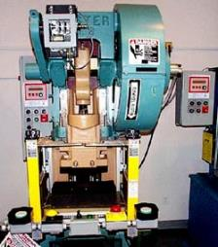
Pre-Rule Stage:
Mechanical Power Presses
OSHA’s current standard is 40 years old and does not address technological changes or the use of hydraulic or pneumatic power presses.
OSHA plans to analyze comments received through its July 2021 Request for Information (RFI) in December 2023.
Notes:
The current OSHA standard on mechanical power presses (29 CFR 1910.217) is approximately 40 years old and does not address technological changes or the use of hydraulic or pneumatic power presses.
OSHA previously published an ANPRM on Mechanical Power Presses (June 2007) in which it identified several options for updating this standard.
The agency issued a Request for Information on July 28, 2021 (86 FR 40651) seeking information regarding whether it should update the standard, mechanical, if so, how closely the standard should follow the current ANSI B11.1 standard. OSHA also sought information on the types of presses that should be covered, the use and certification of equipment, and other topics such as presence-sensing device initiation (PSDI) systems, and requirements for press modifications, training, and injury reporting.
OSHA plans to use the information received in response to this RFI to determine what action, if any, it may take to reduce regulatory burdens while maintaining worker safety.
The RFI comment period closed October 26, 2021.
OSHA will analyze comments in December 2023.

Slide 58

Pre-Rule Stage: Workplace Violence in Health Care and Social Assistance
Labor unions petitioned OSHA to issue a standard on preventing workplace violence in health care. OSHA granted the petitions in January 2017.
OSHA previously issued a request for information (RFI) asking health care employers and workers about the impact of workplace violence and prevention strategies.
OSHA plans to analyze the Small Business Regulatory Enforcement Fairness Act (SBREFA) report in December 2023.
Notes:
OSHA issued a Request for Information on December 7, 2016 (81 FR 88147) that provides OSHA's history with the issue of workplace violence in health care and social assistance, including a discussion of the Guidelines that were initially published in 1996, a 2014 update to the Guidelines, the agency's use of 5(a)(1) in enforcement cases in health care. The RFI solicited information primarily from health care employers, workers and other subject matter experts on impacts of violence, prevention strategies, and other information that will be useful to the agency.
OSHA was petitioned for a standard preventing workplace violence in health care by a broad coalition of labor unions, and in a separate petition by the National Nurses United. On January 10, 2017, OSHA granted the petitions.
OSHA plans to initiate the Small Business Regulatory Enforcement Fairness Act (SBREFA) process in September 2022.
OSHA completed the SBREFA May 1, 2023
OSHA plans to analyze the SBREFA in December 2023

Slide 59

Pre-Rule Stage:
Blood Lead Level for Medical Removal
OSHA’s lead standards for general industry and construction are over 35 years old, and recent medical findings indicate that even at levels below the OSHA standard, blood lead levels (BLLs) in adults can result in adverse health effects.
OSHA planned to issue an Advanced Notice of Proposed Rulemaking in June 2022.
OSHA plans to analyze ANPRM comments in December 2023
Notes:
OSHA is considering rulemaking to revise its standards for occupational exposure to lead. OSHA lead standards provide medical removal levels of 60 µg/dL in general industry, 50 µg/dL in construction and the return of the employee to former job status at a blood lead level (BLL) below 40 µg/dL.
Recent medical findings indicate that lower blood lead levels in adults can result in adverse health effects including hypertension, cognitive dysfunction, and effects on renal function and reproductive systems.
OSHA is seeking input on reducing the current BLL triggers in the medical surveillance and medical removal protection provisions of the general industry and construction standards for lead, and about how current ancillary provisions in the lead standards can be modified to reduce worker BLLs in industries and occupations where elevated exposure to lead continues to occur. OSHA is seeking this input from the public to help the agency identify possible areas of the lead standards for revision to improve protection of workers in industries and occupations where preventable exposure to lead continues to occur.
OSHA planned to issue an Advanced Notice of Proposed Rulemaking in June 2022 to help identify possible areas of the lead standards for revision to improve protection of workers
ANPRM issued June 28, 2022 (87 FR 38343)- Comments due August 29, 2022
ANPRM comments period extension ended October 28, 202
OSHA plans to Analyze the comments in December 2023

Slide 60
Pre-Rule Stage: Heat Illness Prevention
Heat is the leading weather-related killer, and it is becoming more dangerous.
OSHA relies on the General Duty Clause (OSH Act Section 5(a)(1) to protect workers from heat hazards; several states have issued heat protection rules.
OSHA plans to initiate its Small Business Regulatory Enforcement Fairness Act (SBREFA) in August 2023
Notes:
Heat is the leading weather-related killer, and it is becoming more dangerous as 18 of the last 19 years were the hottest on record.
Excessive heat can cause heat stroke and even death if not treated properly. It also exacerbates existing health problems like asthma, kidney failure, and heart disease.
Workers in agriculture and construction are at highest risk, but the problem affects all workers exposed to heat, including indoor workers without climate-controlled environments. Essential jobs where employees are exposed to high levels of heat are disproportionately held by Black and Brown workers.
OSHA currently relies on the general duty clause (OSH Act Section 5(a))(1)) to protect workers from this hazard. To date, California, Washington, Minnesota, and the US military have issued heat protections.
OSHA issued an Advanced Noticed of Proposed Rulemaking (ANPRM) on October 27, 2021 and extended the comment period for the potential rulemaking through January 26, 2021. OSHA will analyze comments in June 2022
Initiate SBREFA in August 2023

Slide 61
OSHA: Long-Term Actions
Injury and Illness Recordkeeping
  OSHA proposed to restore the Musculoskeletal Disorders (MSD) column to the OSHA 300 log.
Shipyard Fall Protection
  OSHA issued an RFI in 2016 to solicit data and comments on updating existing standards and dividing the rulemaking into three subparts
Powered Industrial Trucks
  OSHA issued a Request for Information (RFI) on March 11, 2019 to regarding PIT locations of use, maintenance, training, and operation
Lock-Out/Tag-Out
  OSHA issued a request for information (RFI) in May 2019 to help it understand the strengths and limitations of this new technology, and potential hazards to workers.
Silica in Construction- Table 1
  OSHA is evaluating whether revisions to Table 1 of the silica standard for construction may be appropriate.
COVID-19 Vaccination and Testing Emergency Temporary Standard
  OSHA withdrew this ETS as an enforceable standard; however, it serves as a proposed rule while OSHA evaluates next steps.
Notes:
This slides lists regulatory actions classified as “long-term.” This generally means that any OSHA action is more than one year away.
Injury and Illness Recordkeeping
OSHA proposed to restore the Musculoskeletal Disorders (MSD) column to the OSHA 300 log.
Shipyard Fall Protection
OSHA issued an RFI to solicit data and comments on updating existing standards and dividing the rulemaking into three subparts: subpart E, Stairways, Ladders and Other Access and Egress; subpart M, Fall Protection; and subpart N, Scaffolds.
Powered Industrial Trucks
OSHA issued a Request for Information (RFI) on March 11, 2019 (84 FR 8633), to determine whether changes need to be made to locations of use, maintenance, training, and operation of powered industrial trucks.
Note: In a Long-Term Action, OSHA is collecting information to evaluate the need to update requirements related to the maintenance and use of powered industrial trucks and training of operators. This is a separate activity from the Powered Industrial Trucks Design Standard Update, discussed on a previous slide, that is currently in the Proposed Rule Stage.
Lock-Out/Tag-Out
Technological advancements using computer-based controls of hazardous energy (e.g., mechanical, electrical, etc.,) are more prevalent and conflict with the current standard. The agency has recently seen an increase in requests for variances for these devices.
Silica in Construction- Table 1
OSHA is evaluating whether revisions to Table 1 of the silica standard for construction may be appropriate. includes dust control methods for certain
equipment/tasks. Employers that follow Table 1 are not required to measure workers’ silica exposure and are not subject to the PEL. OSHA is evaluating this
information to determine if revisions to Table 1 may be appropriate.
COVID-19 Vaccination and Testing Emergency Temporary Standard
OSHA published an emergency temporary standard to protect workers from the grave danger of COVID-19 transmission in the workplace. The standard required all covered employers to develop and implement a mandatory COVID-19 vaccination policy, with an exception for employers that instead adopt a policy requiring employees to elect either to get vaccinated or to undergo regular COVID-19 testing and wear a face covering at work.
On January 13, 2022, the U.S. Supreme Court stayed the Vaccination and Testing ETS, finding that challengers were likely to prevail on their claims. After evaluating the Court's decision, OSHA withdrew the Vaccination and Testing ETS as an enforceable emergency temporary standard. OSHA did not withdraw the ETS to the extent that it serves as a proposed rule while OSHA continues to evaluate comments and the Court’s decision.
OSHA’s next action is undetermined.

Slide 62

OSHA
www.osha.gov
800-321-OSHA (6742)

