Slide 1
Agenda
Welcome
  Begin Safely and Respectfully
    EAP for this site, AED in Lobby
    Phones to STUN
    Review of ASSP CLEAR Values
  Introductions – Virtually and In Person
    Name
    Currently working in ? ? Industry
    Number of years in Safety/EHS/HSSE, etc., present Role ? ?
Advisory Group Update – “Learning to Pivot”
  How can the Pensacola Chapter/ ASSP help you succeed?
Notes:
ERIC
Today’s purpose: we’ll discuss why it important to pivot in our work as OSH Professionals, how to approach making that pivot and discuss our experiences with pivoting in our roles.
Agenda overview (briefly run through each item ):
Learning to Pivot: a short overview of the pivot framework and 2–3 concrete examples — listen for a simple repeatable method you can use.
Breakout Discussions : small groups will discuss one scenario and apply the framework. Each group should pick a note-taker and a spokesperson.
Report Out : each group will share their key insights relating to our topics. We’ll capture themes and any action items.
Reminders & Next Steps (5 min): resources, reminders and our next steps.
Expectations for breakouts: focus on applying the steps, be concise, capture concrete takeaways or actions, and decide one person to report out.
Wrap-up cue: after report-outs we’ll summarize common themes and confirm any assigned next steps and deadlines.

Slide 2

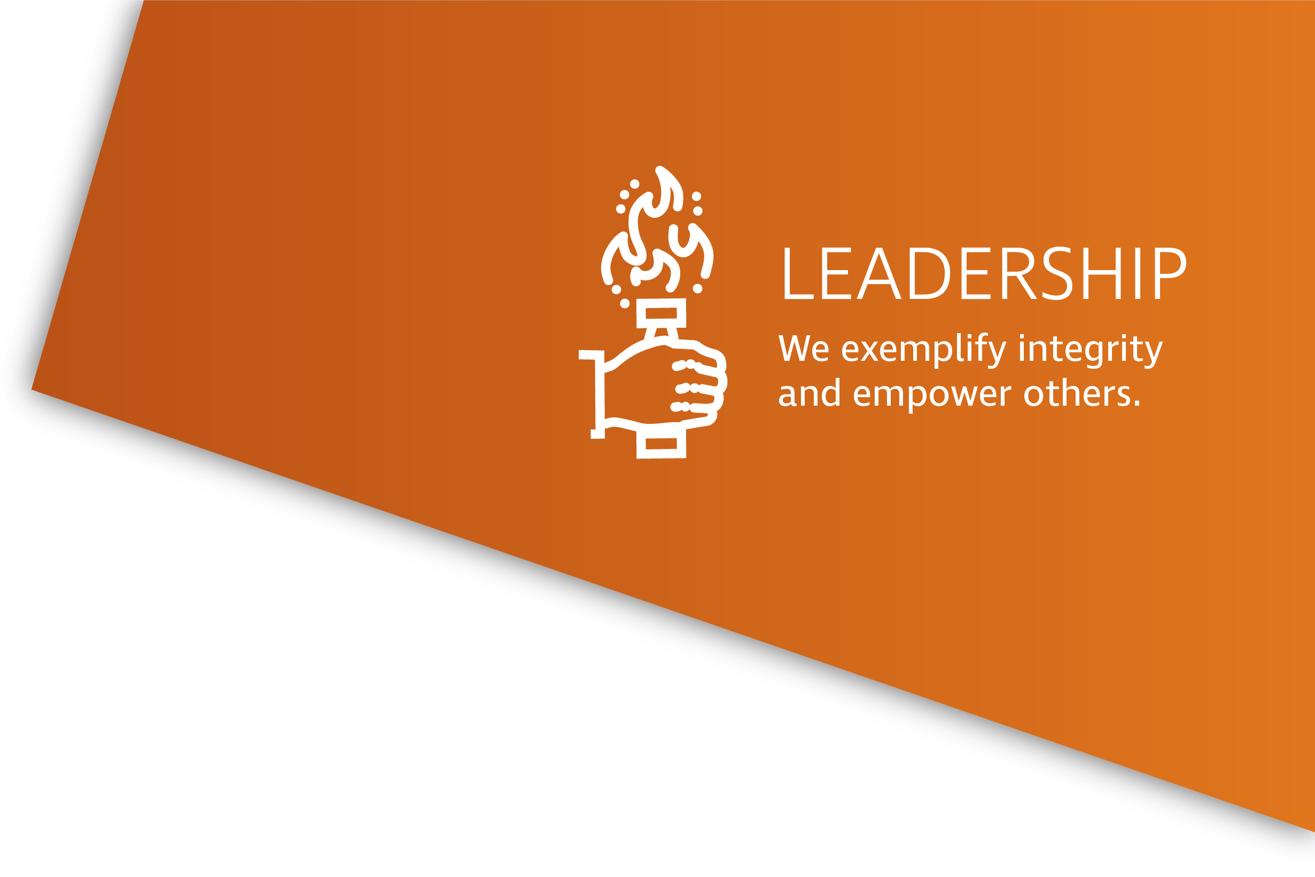

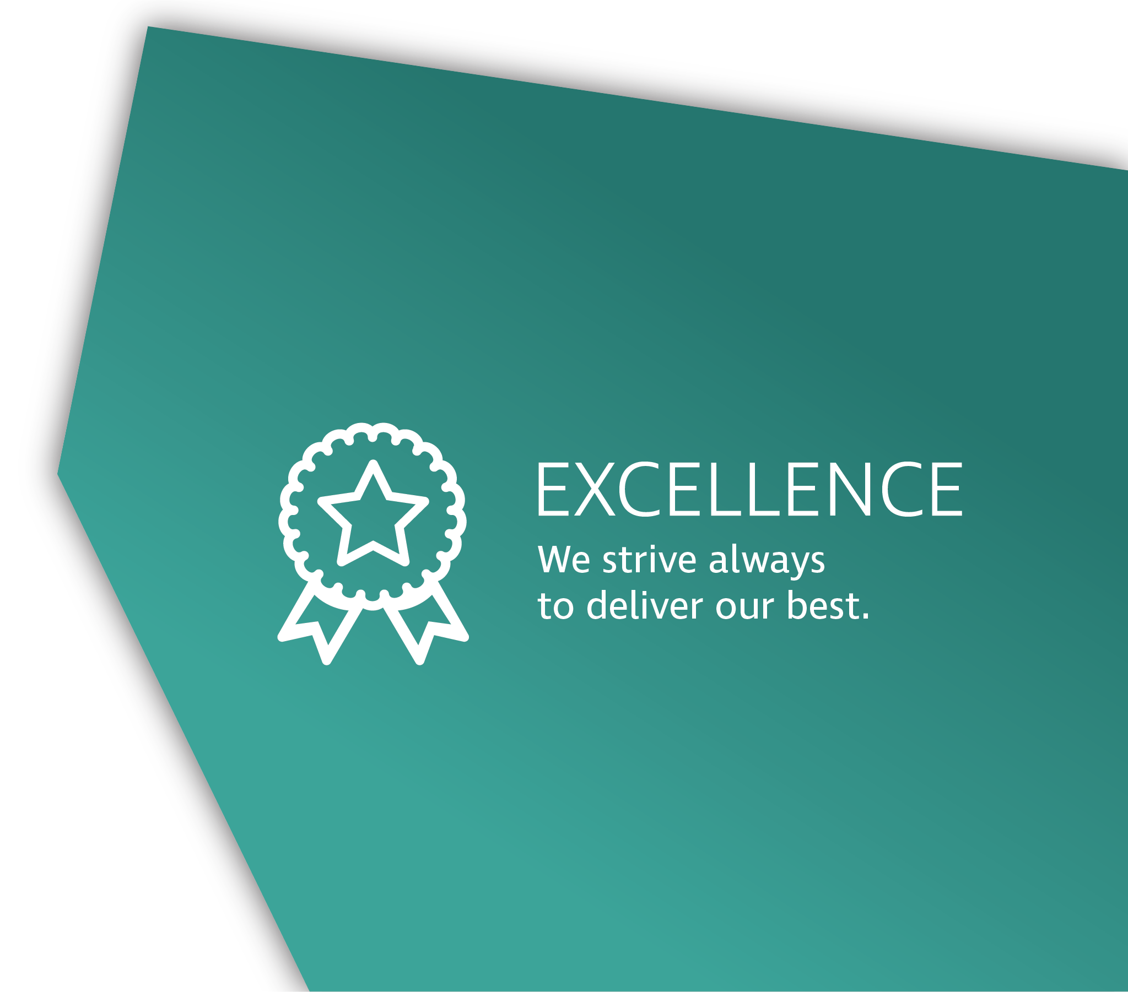


Notes:
CLEAR Values
ASSP’s CLEAR values set expectations for how we as a community interact.
CLEAR VALUES
Community: We provide a welcoming and collaborative environment that creates belonging and inclusivity for all.
Leadership: We exemplify integrity and empower others.
Excellence: We strive always to deliver our best.
Accountability: We are ethical, reliable and trustworthy in all we do.
Respect: We act with humility, listen to others and foster strong working relationships.
Our CLEAR values guide our behavior, decisions and actions – with our peers and our members. It is both What we Do and How we Choose to Do It.

Slide 3
Learning to Pivot
Advisory Group
October 2025

Slide 4

Pivoting
Notes:
ERIC
When faced with a challenge, we have to react quickly. How we do that can impact the success of our work. Here is an example of one way to do that.

Slide 5
What does it mean to Pivot?
Pivot: To shift strategically in anticipation of or response to a change in conditions, constraints, or opportunities
In safety: Adjusting methods, tools, and priorities without abandoning core safety principles
Notes:
ERIC
Whether we plan to or not, we likely make decisions to pivot every day. It might be an event during production, a traffic delay that alters our usual commute, or shifts in macroeconomic conditions that force us to change materials or suppliers. The decisions we make in response to changing circumstances can be the difference between success and an unforeseen incident that impacts lives.
My team recently had to make an important pivot in our work to meet a rush request that came in from a customer to support a construction project they had. The project was in a challenging climate and was mixed in with close proximity to their guests. The request was difficult to meet as we had to find the right consultant with the needed skills, availability and resources to support them in a hot environment. Now, that isn't an overly complex example, but it was one my team did not expect and we had to pivot our work to support this client.
As OSH Professionals we take in all these different pieces of information and work to meet the challenge to support our business while protecting our people, equipment, processes and brand. Heavy stuff right? I am sure you all feel and even thrive from the challenge. As our world becomes increasingly intertwined and complex, we must maintain our focus while not abandoning our safety principles. Like any skill, we need to learn and develop in it. So, lets explore this skill.
Kamil.....

Slide 6
Why Pivoting Matters
Workplaces are in constant flux
Stakeholders expect agility
Safety = anticipation, not just reaction
Notes:
KAMIL
If we, as safety professionals don't learn to pivot, we risk becoming irrelevant – or worse, exposing working to unaddressed hazards.

Slide 7
Four Forces Driving the Need to Pivot
Technology
Competition
Financial
Risks
Notes:
KAMIL
There are 4 forces driving a safety professionals need to pivot. They are:
Technology, Competition, Financial, Risks.
Let's look at each in more detail

Slide 8
Technology
AI, wearables, real-time monitoring, automation
Challenges: resistance to adoption, steep learning curves
Skills: curiosity, digital fluency, cross-functional collaboration
Notes:
LISA
Technology is one of the fastest-moving forces requiring us to pivot. We’re seeing AI used for predictive analytics, wearables tracking worker fatigue or exposure, drones conducting inspections, and automation reducing repetitive tasks.
But here’s the challenge: many workers—and even leaders—resist adopting new tools. Sometimes it’s fear of being replaced. Other times, it’s simply the steep learning curve that comes with change.
As safety professionals, we don’t have to become IT engineers—but we do need to be curious. That means asking: How could this tool reduce incidents? How do we ensure data privacy and human factors are addressed?
And most importantly, pivoting here means collaborating across functions—working with IT, HR, and operations so safety isn’t an afterthought, but built into technology from the start.

Slide 9
Competition
Competing with internal priorities: production, cost, efficiency
Competing for external talent and reputation
Skills: Positioning safety as a business advantage, benchmarking, communicating ROI
Notes:
LISA
Competition might not be the first thing we think of in safety, but it plays a big role.
Inside our organizations, safety often competes with other priorities: production goals, efficiency targets, cost savings. If leaders see safety as a barrier instead of an enabler, safety will lose that competition.
Externally, companies are competing for talent and customers. And here’s the pivot: a strong safety culture is a competitive advantage. Workers want to go home safe, and they want to join companies where they feel valued. Customers want to work with companies that protect people and the environment.
So how do we pivot? By positioning safety as part of the business strategy. Benchmarking against industry leaders, learning from peers, and—most importantly—speaking the language of ROI. Instead of just saying ‘we avoided accidents,’ frame it as ‘we saved X dollars in reduced downtime, turnover, and claims.’ That shifts safety from being seen as a cost to being seen as a driver of value.

Slide 10

Financial Pressures
Limited Budgets "do more with less"
Short term cost vs. Long term savings
Skills: Prioritization, business case building, linking safety to productivity
Notes:
SCOTT
Financial pressures are constant. Every department is being asked to do more with less, and safety is no exception.
The trap we have to avoid is letting safety be viewed as a ‘nice-to-have’ that gets cut when budgets are tight. That’s where pivoting becomes critical.
First, it’s about prioritization. Not every initiative can move forward at once—focus on what has the highest impact on risk reduction.
Second, safety leaders must become business leaders. That means building a clear business case: showing the return on investment in safety. A single avoided injury can save thousands in direct and indirect costs.
Discuss how you can coordinate with other departments to combine efforts.
One example, we had a loading dock where employees commonly used that was not covered. This created a concern for slips including ice/winter weather. We coordinated a business case with other departments (including Production and Maintenance). Employees did not like spending time in inclement weather (rain). This project was completed in a timely manner.
Finally, link safety to productivity. Safer workplaces have fewer disruptions, lower turnover, and stronger morale. That’s not just a safety win—that’s a financial win. And that’s how you pivot when budgets are squeezed.”

Slide 11
Risk
Emerging Risks: stress, supply chain, climate, AI misuse
Challenges: unknowns & shifting regulations
Skills: scenario planning, comfort with ambiguity, fast-decision-making
Notes:
SCOTT
Risk is the heart of our profession, and it’s constantly evolving. It’s no longer just slips, trips, and falls. We’re now managing psychosocial risks like stress and burnout, supply chain vulnerabilities, the effects of climate change, and even unintended consequences of AI.
The challenge is that many of these risks are unpredictable. Regulations shift, industries evolve, and sometimes we’re preparing for things we’ve never seen before.
That’s why pivoting is essential here. We need to build skills in scenario planning—asking ‘what if’ and running through possible futures. We need to get comfortable with ambiguity, making decisions even when the data isn’t perfect. And we need to act quickly, because hesitation in a risk environment can mean real harm.
Pivoting around risk doesn’t mean being reckless—it means being flexible, proactive, and resilient in the face of uncertainty.
In my current role, our team encounters electrical risks due to work on transmission substations and lines. This summer we had high load demand due to the high temperatures on the east coast. With long days, fatigue and extreme temperatures, we coordinated working on select Friday's (allowing overtime for crews). We felt more comfortable reducing the stress for employees while they appreciated the extra $. An added benefit was increased productivity for several projects.

Slide 12
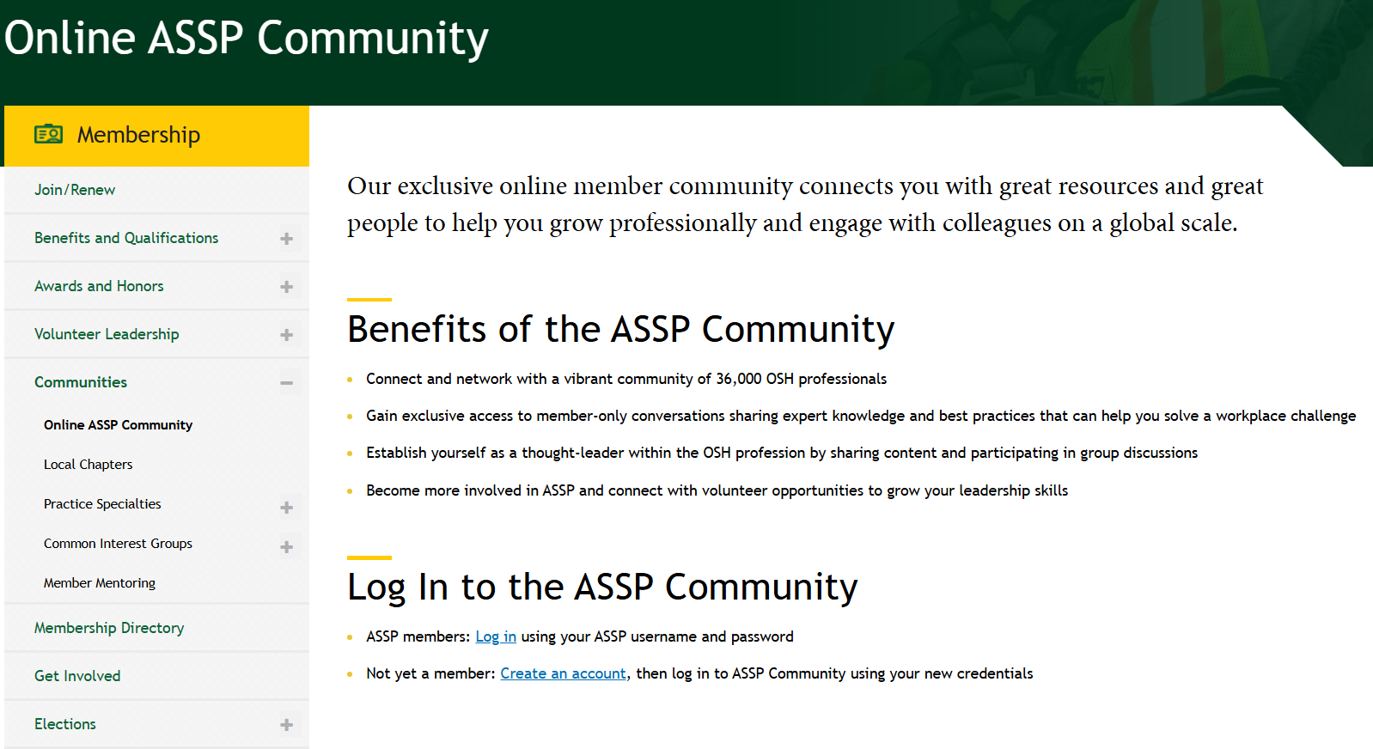
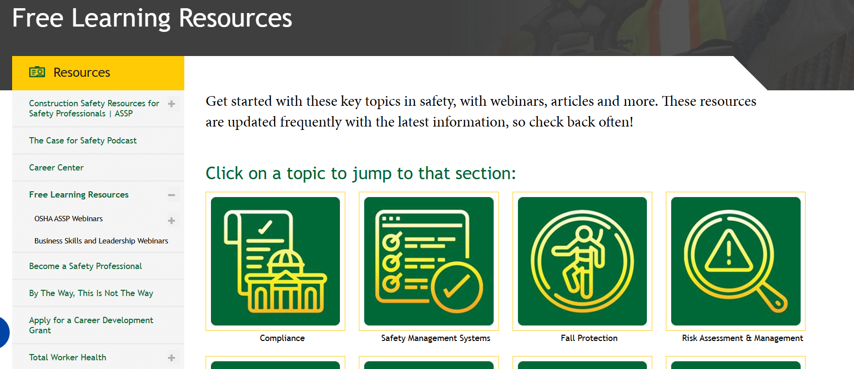

Putting It All Together
To pivot effectively, safety professionals need:
Curiosity – Keep learning
Agility – Adjust quickly
Strategic Framing – Link safety to business goals
Courage – Lead change, even when it is uncomfortable
Notes:
NICK
These four qualities are what transform safety professionals into adaptive leaders. (review list)
Because at the end of the day, pivoting is a change in strategy without a change in vision. Remember, it is impossible to get stuck somewhere if you keep learning something new.

Slide 13
Putting It All Together
To pivot effectively, safety professionals need:
Curiosity – Keep learning
Agility – Adjust quickly
Strategic Framing – Link safety to business goals
Courage – Lead change, even when it is uncomfortable
Notes:
NICK
These four qualities are what transform safety professionals into adaptive leaders. (review list)
Because at the end of the day, pivoting is a change in strategy without a change in vision. Remember, it is impossible to get stuck somewhere if you keep learning something new.

Slide 14
"Pivoting isn’t plan B; it’s part of the process"
-Jeff Goins, The Art of Work
Notes:
NICK
Pivoting allows us to stay relevant, resilient, and respected as leaders in our organizations.
The next time your organization faces change, don’t resist it—pivot with it, and lead the way. Use this time to learn from your peers, share your best practices, and engage with fellow AG members on what has worked, and not worked, within your workplace.

Slide 15
Questions to Consider
How do we prepare our teams to adapt to evolving safety risks? What ASSP training, webinars, or publications could support this preparation?
What skills or traits help safety professionals pivot to any of the four factors (Technology, Competition, Financial, Risk)? How has ASSP helped you (or could help others) build those adaptive skills?
Notes:
KAMIL
Set up questions (Staff will also put questions in chat)
Staff will put link in chat for notes. Please click on the link prior to heading to your breakout room. But only one person needs to submit for each room (although we always welcome indviduals thoughts).
20 – 30 minutes

Slide 16
Reminders
Our next meeting is December 11th @11am CT
  Calendar invite sent in August
Communication is a two-way street
Advisory Group Webpage
Reach out to Operations Committee or Governance staff at governance@assp.org
Notes:
DALLAS
Note date/time of next meeting and that if they did not receive the calendar invite to reach out to staff at email below and we can resend
Remind them that their role on the AG means that not only do they bring insight and information TO the AG meetings, but also bring topics discussed BACK to their communities.
Remind them that presentations and information is available on the AG Webpage of the ASSP website (Staff will put link in chat)
Remind them that they can reach out to OC or staff at goveranance@assp.org

Slide 17
THANK YOU
Notes:
NICK

